Slide 1
WT-436i2 Use Case : Intelligent Control of Large-scale Wi-Fi
Haomian Zheng, Guoxiang Liu, Aihua Guo
May 30, 2023

Slide 2
Background
In Fiber-to-the-room (FTTR) and other similar network scenarios, there are dense ONU deployments with Wi-Fi APs in a small area
Hundreds of ONUs in a mid-size enterprise FTTR deployment
# of users connected to different ONU Wi-Fi APs vary depending on the movement and bandwidth requirements of the users
The interference between the Wi-Fi APs can significantly degrade the quality of service and user experiences.
FTTR deployments

Slide 3
Challenges
Very challenging to identify the interference and timely improve the QoE of users in such a dynamic and large-scale Wi-Fi deployment
Intelligent Wi-Fi control architecture is needed to
Collect the real-time status of Wi-Fi signals and usages
Identify the interference in real time
Provide timely adjustments to resolve the interference issue

Slide 4
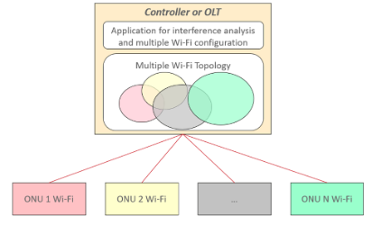
Proposed Solution
Scenario-based AI Algorithms
Centralized Wi-Fi network control on OLT devices or on the controller
The status of Wi-Fi network composed by multiple ONUs can be collected and represented as multiple Wi-Fi topologies
AI-based analytical algorithms may be used to analyze and generate dynamic Wi-Fi configurations to optimize the signal performance
3
2
1
4
Intelligent Wi-Fi control:
Real-time status, e.g., neighbor info, channel status, channel power, of Wi-Fi devices are streamed to the controller / OLT
The controller / OLT builds up Wi-Fi topologies based on the collected data
The network resource utilization and interference spots are analyzed. Scenario-based AI algorithms can be used to create optimal Wi-Fi configurations
The optimal Wi-Fi configurations are pushed to the ONUs and take effect

Slide 5
Updated Requirements for AIM Framework & Interface
AIM Framework:
Supports large-scale data processing, training and analysis with embedded AI capabilities in the AIM basic components, pipelines and applications
Supports the storage of large-scale data collected from massive numbers of ONU devices
The Wi-Fi control and AI algorithms can be deployed in a distributed way on the controller and embedded on OLT devices
AIM Interfaces:
Supports real-time streaming telemetry of Wi-Fi performance data from massive number of devices to the controller/OLT
Supports real-time streaming telemetry between ONU and OLT with proper extensions to the OMCI, especially when the Wi-Fi control and AI algorithms are deployed on the OLT
Supports the storage of large-scale data collected from massive numbers of ONU devices

Slide 6
Summary
Wi-Fi signal interference exists and can significantly degrade user experience when large number of ONUs (with Wi-Fi APs) are present in a small area
Centralized Wi-Fi control is needed to identify and resolve Wi-Fi interference through dynamic configuration. AI algorithms can be used to support this intelligent operation
The AIM framework needs to be extended to support this use case

